Slide 1
NTUA-SLP at SemEval-2018 Task 3: Tracking Ironic Tweets using Ensembles of Word and Character Level Attentive RNNs
Christos Baziotis, Nikos Athanasiou, Pinelopi Papalampidi,Athanasia Kolovou,
Georgios Paraskevopoulos, Nikolaos EllinasAlexandros Potamianos

Slide 2
Data
Unlabeled Dataset
We collected a dataset of 550 million archived English Twitter messages
from Apr. 2014 to Jun. 2017
(1) calculating word statistics needed in our text preprocessing
(2) training word2vec word embeddings
the skip-gram model
negative sampling of 5 and minimum word count of 20
utilizing Gensim’s implementation
The resulting vocabulary contains 800,000 words

Slide 3
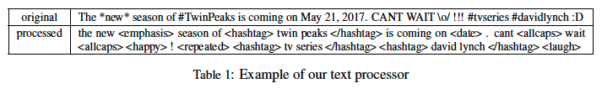
Preprocessing
Utilize the ekphrasis2 (Baziotis et al., 2017) tool as a tweet preprocessor
http://github.com/cbaziotis/ekphrasis
The preprocessing steps included in ekphrasis are
Twitter-specific tokenization
spell correction
word normalization (e.g. #TwinPeaks → <hashtag> )
word segmentation (for splitting hashtags)
word annotation

Slide 4
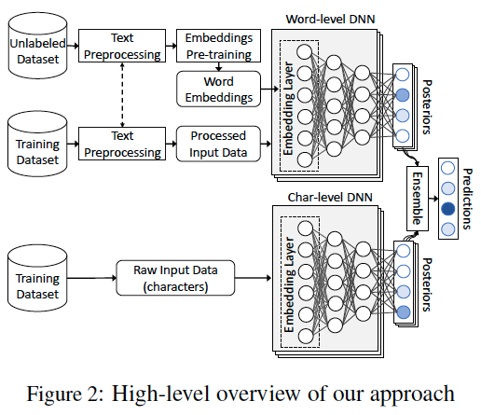
Model
Designed two independent deep-learning models
the first model operates at the word-level
capturing the semantic information of the tweet
the second model at the character-level
capturing the syntactic information
Both models share the same architecture

Slide 5
Embedding Layer
Character-level
The input to the network is a Twitter message, treated as a sequence of characters.
We randomly initialize the weights of the embedding layer and learn the character embeddings from scratch.
Word-level
The input to the network is a Twitter message, treated as a sequence of words
We initialize the weights of the embedding layer with our pretrained word embeddings

Slide 6
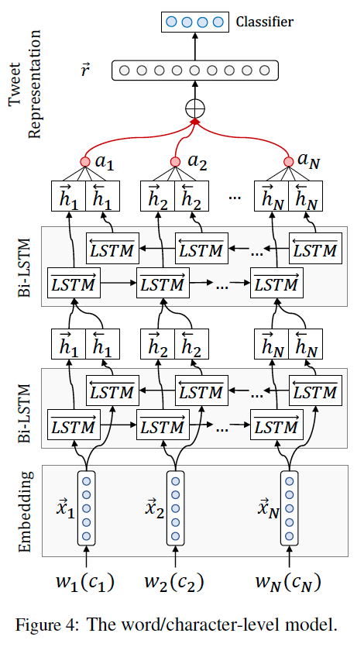
Model
Embedding Layer
Character-level
The input to the network is a Twitter message, treated as a sequence of characters.
We randomly initialize the weights of the embedding layer and learn the character embeddings from scratch.
Word-level
The input to the network is a Twitter message, treated as a sequence of words
We initialize the weights of the embedding layer with our pretrained word embeddings

Slide 7
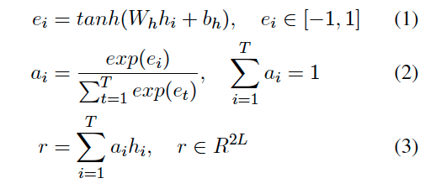
Model
Bi-LSTM
Attention Layer
Output Layer
a fully-connected softmax layer with L neurons

Slide 8
Regularization
Add Gaussian noise to the embedding layer
Dropout
Early-stopping
Do not fine-tune the embedding layers of the word-level model
words in the test set and not in the training set, will remain at their initial position which may no longer reflect their “true” meaning, leading to miss-classifications.

Slide 9

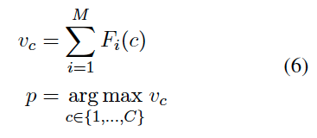
Ensemble
Unweighted Average (UA)
Majority Voting (MV)

Slide 10
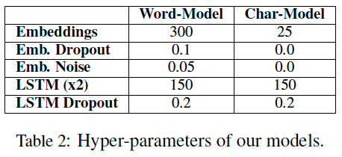
Training
In order to deal with the problem of class imbalances in Subtask B
Apply class weights to the loss function of our models
penalizing more the misclassification of underrepresented classes
weight each class by its inverse frequency in the training set
For optimizing the networks
Use Adam algorithm (Kingma and Ba, 2014) with minibatches of size 32
clip the norm of the gradients (Pascanu et al., 2013) at 1 (对梯度进行裁剪，防止梯度爆炸的问题)
as an extra safety measure against exploding gradients
To find good hyper-parameter values in a relative short time
Adopt the Bayesian optimization (Bergstra et al., 2013) approach

Slide 11
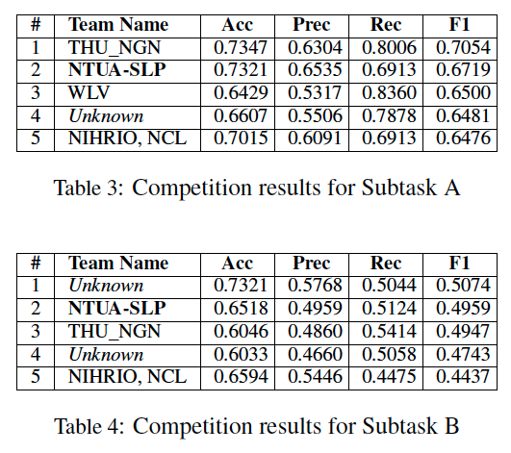
Results

Slide 12
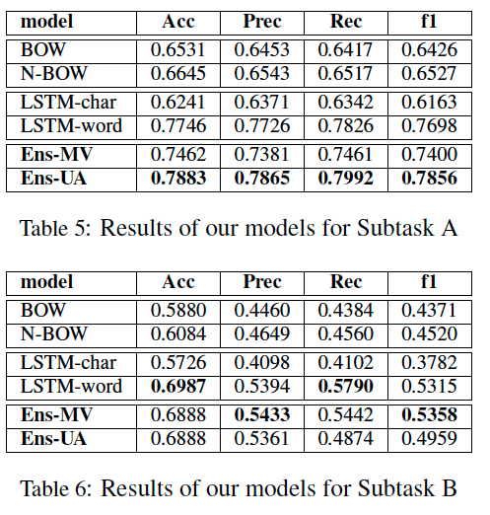
Results
Bag of Words (BOW) model
with TF-IDF weighting.
Neural Bag of Words (NBOW) model
retrieve the word2vec representations of the words in a tweet and compute the tweet representation as the centroid of the constituent word2vec representations
Both BOW and N-BOW features are then fed to a linear SVM classifier
with tuned C = 0:6.

Slide 13
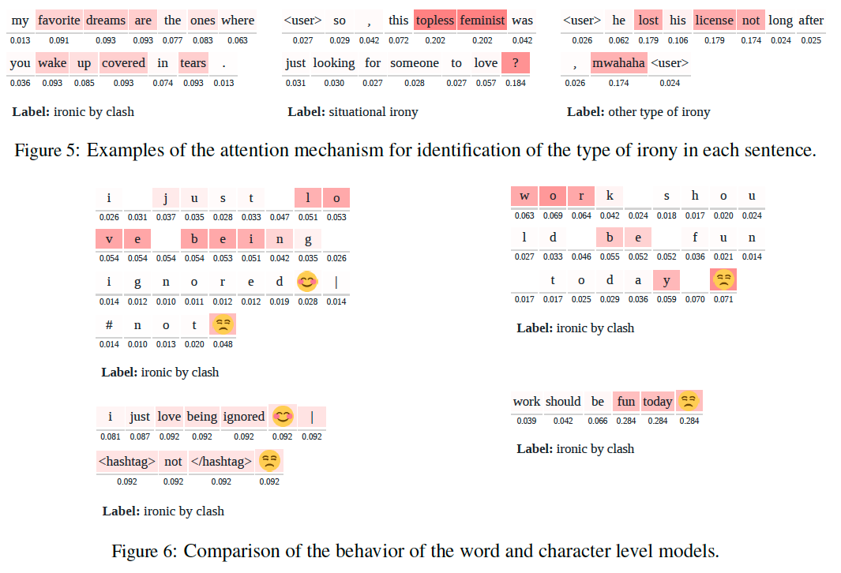
Attention Visualizations

Slide 14
Conclusion
The performance reported in this paper could be further boosted
by utilizing transfer learning methods from larger datasets
the joint training of word- and character-level models can be tested for further improvement of the results.
Finally, we make the source code of our models and our pretrained word embeddings available to the community, in order to make our results easily reproducible and facilitate further experimentation.
http://github.com/cbaziotis/ntua-slp-semeval2018-task3

